Slide 1
English
Unit 1 – My World
WALT: 6Rm.01 Understand, with support, most of the main points of short and extended texts.
6Rm.02 Read independently a range of short, simple fiction and non-fiction texts with confidence and enjoyment.

Slide 2



WALT: Understand, with support, most of the main points of short and extended texts. Read independently a range of short, simple fiction and non-fiction texts with confidence and enjoyment.
I can read a text.
With support, I can answer questions on a text.
Independently, I can answer questions on a text.

Slide 3
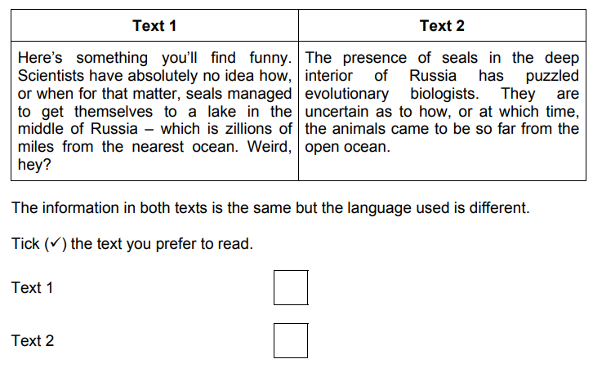
Retrieval Practice
WALT: Understand, with support, most of the main points of short and extended texts. Read independently a range of short, simple fiction and non-fiction texts with confidence and enjoyment.
Explain why you chose the text you did.

Slide 4
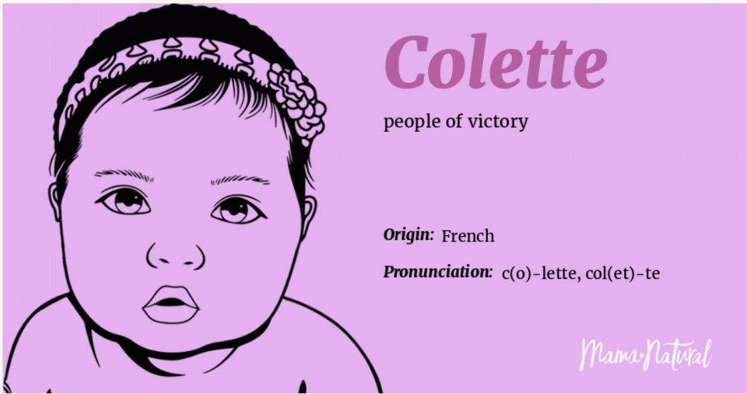

Starter – Does your name have a meaning? What does it mean?
WALT: Understand, with support, most of the main points of short and extended texts. Read independently a range of short, simple fiction and non-fiction texts with confidence and enjoyment.

Slide 5
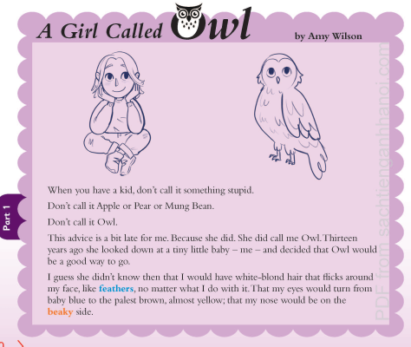
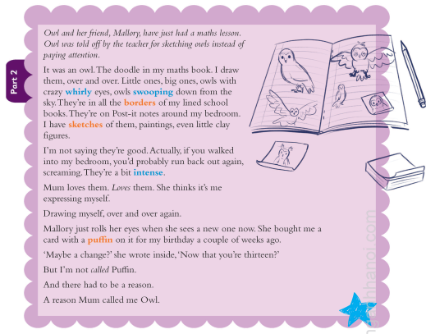
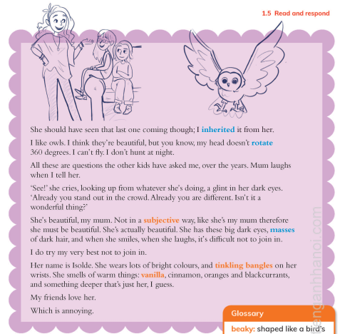
Read this text about “A Girl Called Owl.”
WALT: Understand, with support, most of the main points of short and extended texts. Read independently a range of short, simple fiction and non-fiction texts with confidence and enjoyment.
Pg. 20 - 23

Slide 6
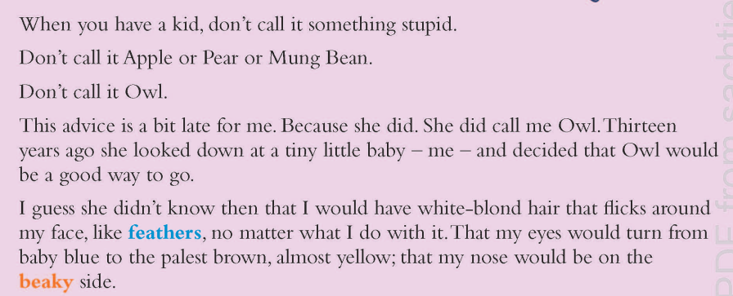
WALT: Understand, with support, most of the main points of short and extended texts. Read independently a range of short, simple fiction and non-fiction texts with confidence and enjoyment.
Now lets read it together.

Slide 7
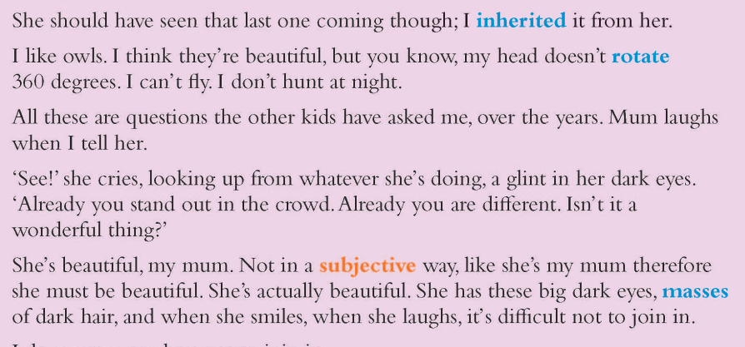
WALT: Understand, with support, most of the main points of short and extended texts. Read independently a range of short, simple fiction and non-fiction texts with confidence and enjoyment.
Now lets read it together.

Slide 8

WALT: Understand, with support, most of the main points of short and extended texts. Read independently a range of short, simple fiction and non-fiction texts with confidence and enjoyment.
Now lets read it together.

Slide 9
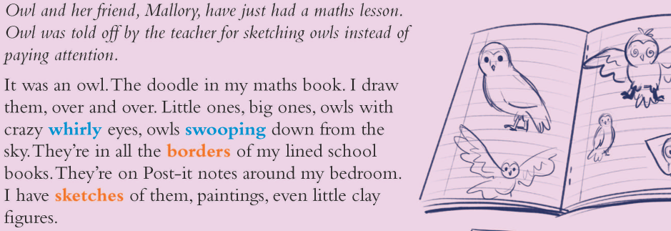
WALT: Understand, with support, most of the main points of short and extended texts. Read independently a range of short, simple fiction and non-fiction texts with confidence and enjoyment.
Now lets read it together.

Slide 10
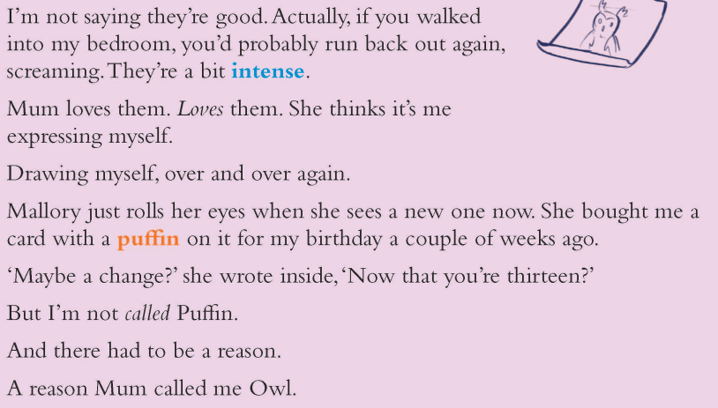
WALT: Understand, with support, most of the main points of short and extended texts. Read independently a range of short, simple fiction and non-fiction texts with confidence and enjoyment.
Now lets read it together.

Slide 11
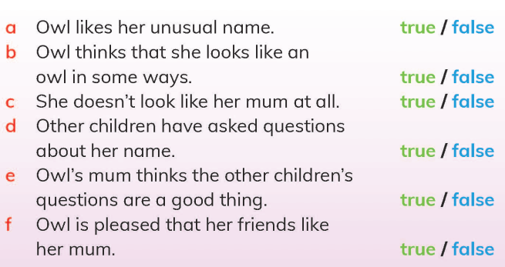
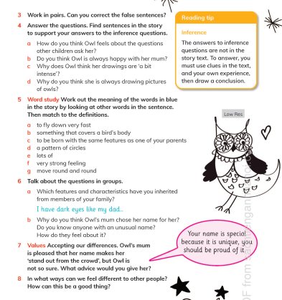
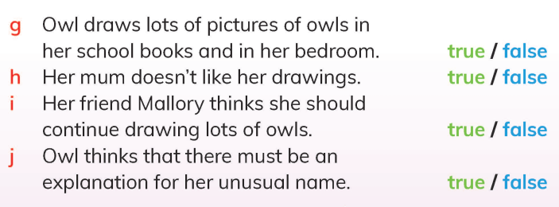
WALT: Understand, with support, most of the main points of short and extended texts. Read independently a range of short, simple fiction and non-fiction texts with confidence and enjoyment.
Now answer questions 2 – 8 in your notebooks.
Page 21 -23

Slide 12
WALT: Understand, with support, most of the main points of short and extended texts. Read independently a range of short, simple fiction and non-fiction texts with confidence and enjoyment.
Now answer questions 2 – 8 in your notebooks.

Slide 13
WALT: Understand, with support, most of the main points of short and extended texts. Read independently a range of short, simple fiction and non-fiction texts with confidence and enjoyment.
Now answer questions 2 – 8 in your notebooks.

Slide 14
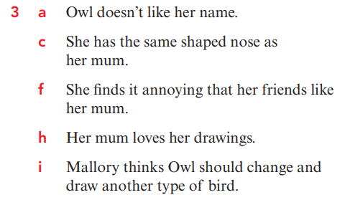
WALT: Understand, with support, most of the main points of short and extended texts. Read independently a range of short, simple fiction and non-fiction texts with confidence and enjoyment.
Now answer questions 2 – 8 in your notebooks.

Slide 15
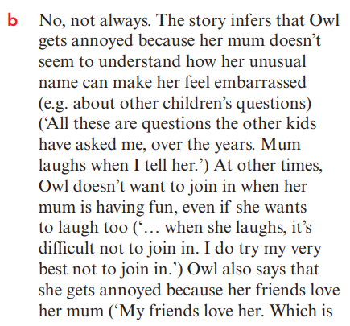
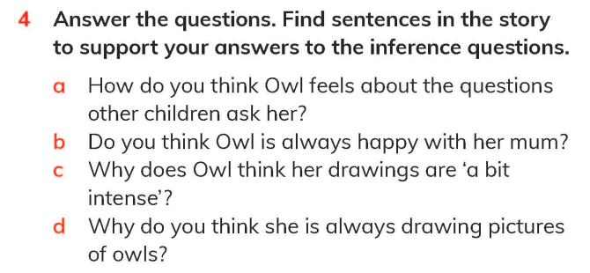
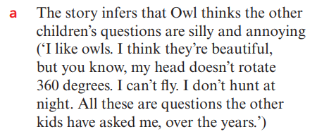

WALT: Understand, with support, most of the main points of short and extended texts. Read independently a range of short, simple fiction and non-fiction texts with confidence and enjoyment.

Slide 16
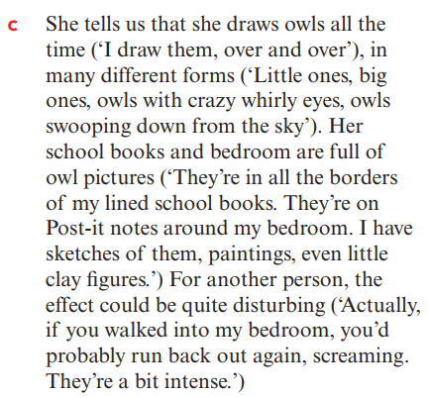
WALT: Understand, with support, most of the main points of short and extended texts. Read independently a range of short, simple fiction and non-fiction texts with confidence and enjoyment.

Slide 17
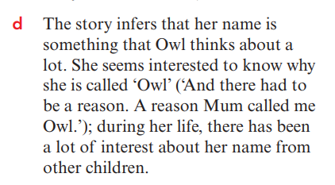
WALT: Understand, with support, most of the main points of short and extended texts. Read independently a range of short, simple fiction and non-fiction texts with confidence and enjoyment.

Slide 18
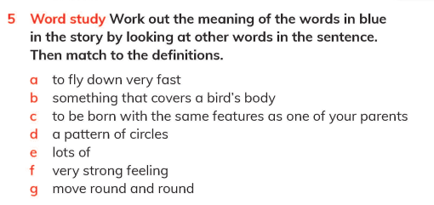
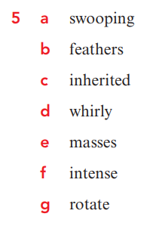
WALT: Understand, with support, most of the main points of short and extended texts. Read independently a range of short, simple fiction and non-fiction texts with confidence and enjoyment.

Slide 19
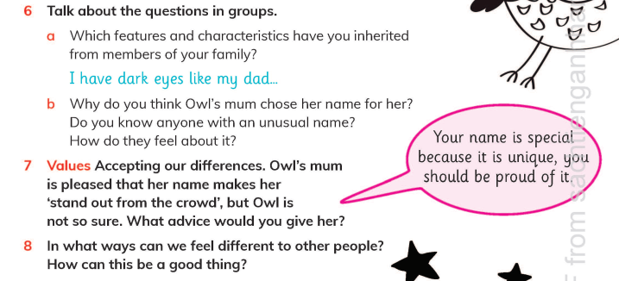
WALT: Understand, with support, most of the main points of short and extended texts. Read independently a range of short, simple fiction and non-fiction texts with confidence and enjoyment.

Slide 20
WALT: Understand, with support, most of the main points of short and extended texts. Read independently a range of short, simple fiction and non-fiction texts with confidence and enjoyment.
I can read a text.
With support, I can answer questions on a text.
Independently, I can answer questions on a text.

Slide 21
Plenary – Did you enjoy the text?
WALT: Understand, with support, most of the main points of short and extended texts. Read independently a range of short, simple fiction and non-fiction texts with confidence and enjoyment.
Why / Why Not?

